Slide 1
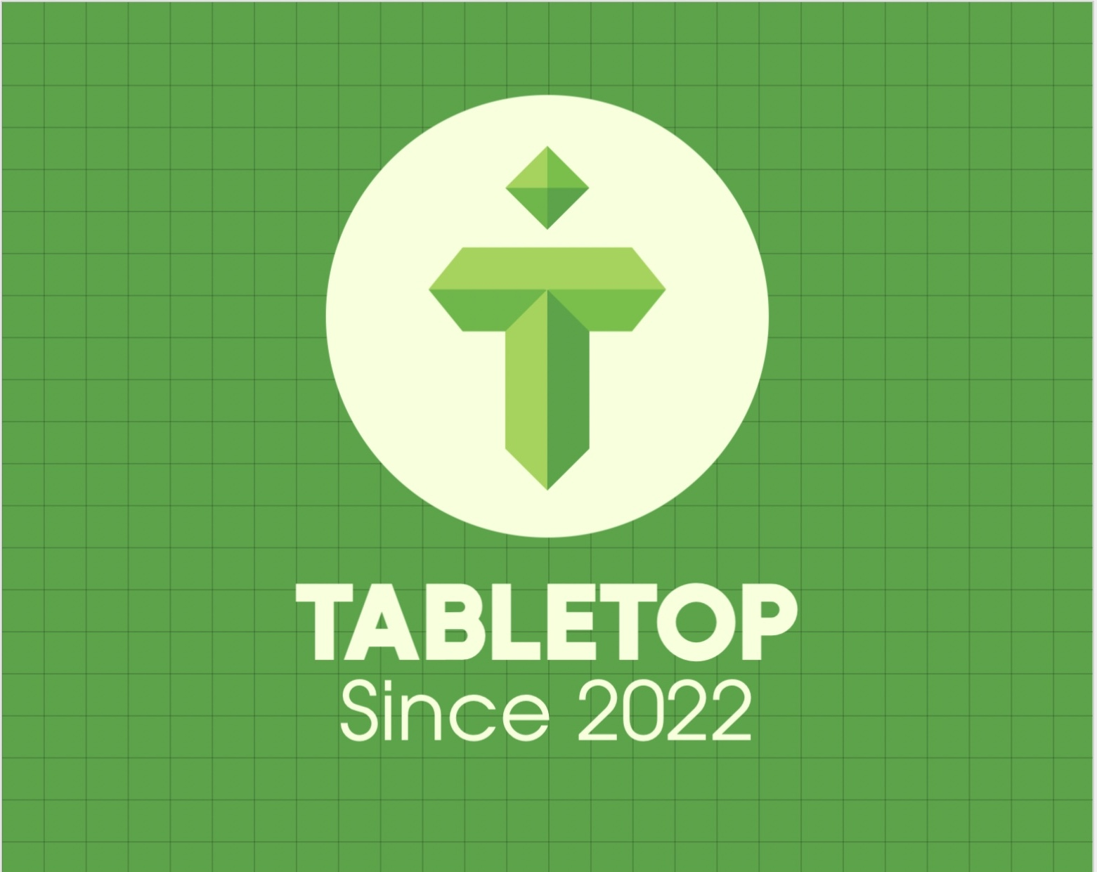
TableTop: A Real-time Restaurant Booking Web Application
Information Systems Capstone Project
Kyle Johns
Eric Skinner
Group 2

Slide 2
Background
How much time have you wasted trying to find a quiet place to study?
How much time have you wasted trying to ask about table availability in a restaurant?
Maybe you called ahead
Maybe you drove to the location only to be met with an hour long wait time
Walking to a location to only find that no seating is available whether it be:
A coffee shop
A library
While the finding a place to study can be cumbersome, we determined that finding a table at a restaurant applied more to the general public

Slide 3
System Planning and Selection
Original problem was time spent attempting to find a seat in a public establishment for:
Quiet study location
Secluded social destination
Narrowed the problem down to restaurants
Evolved into recognition of market gap for online reservation services
Existing platforms such as OpenTable only feature high profile restaurants
Google focuses on foot traffic throughout the day to guess availability
No existing solution for having a guaranteed seat at first-come first-serve categorized locations

Slide 4
System Analysis/Requirements
Need a way to store Customer, Restaurant, and Table data
Need a full Graphical User Interface for customer interaction
Need a way for Restaurant’s to apply for addition to the overall database
Need a report to show reservation confirmation

Slide 5
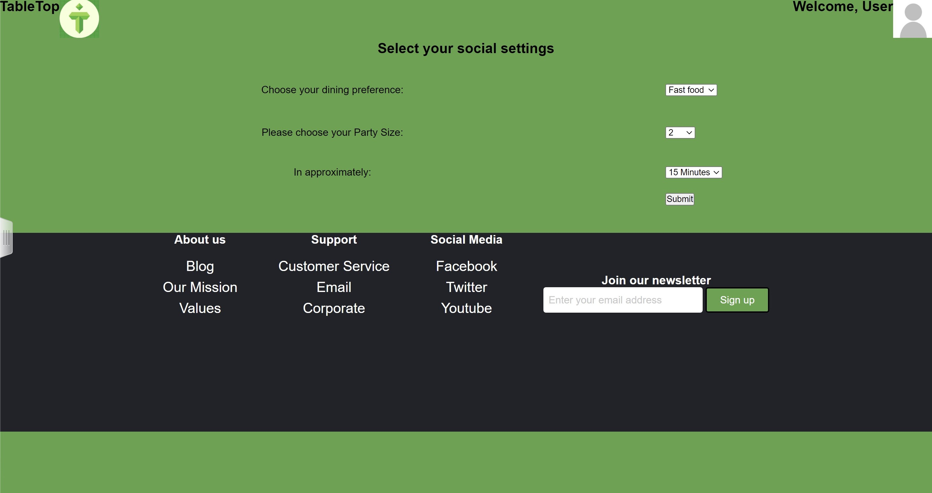
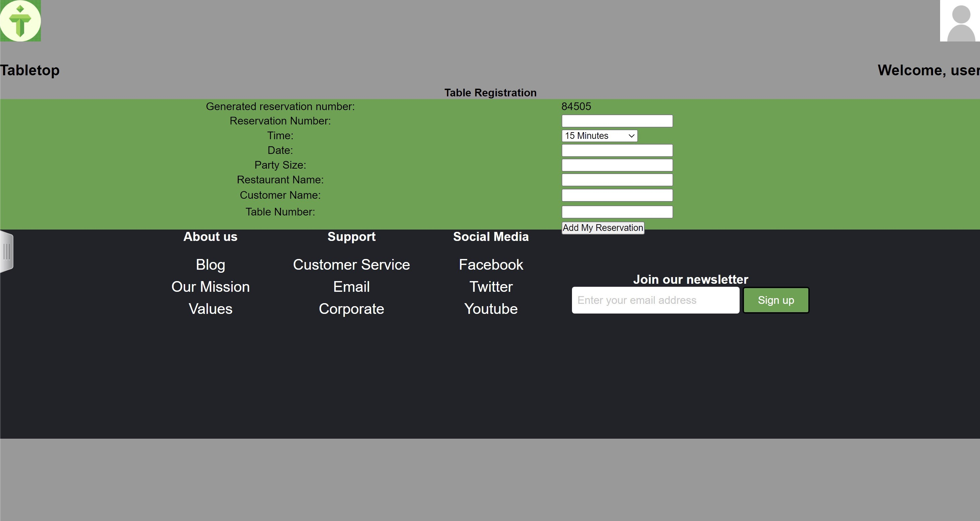
System Design

Slide 6
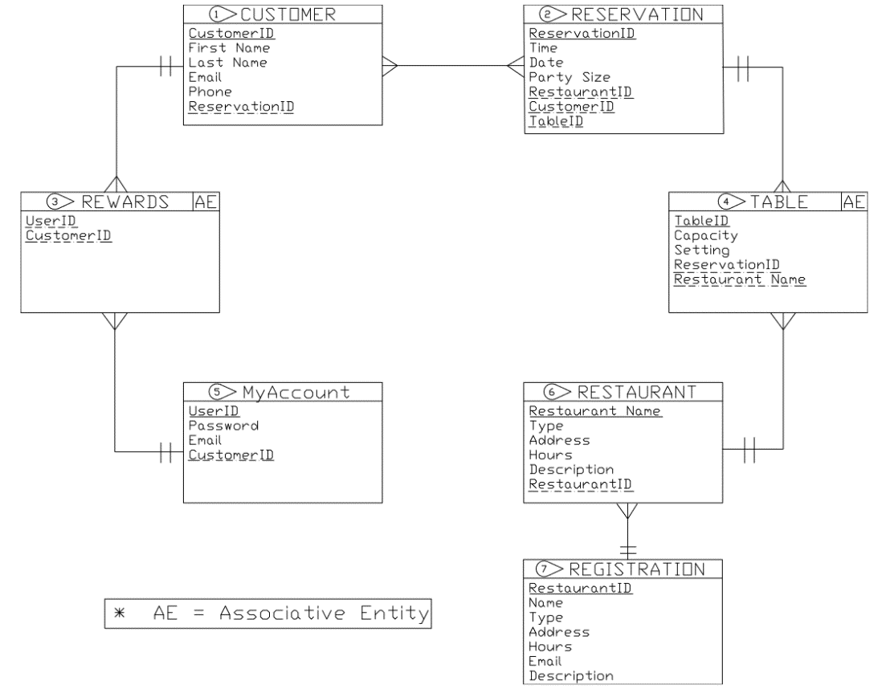
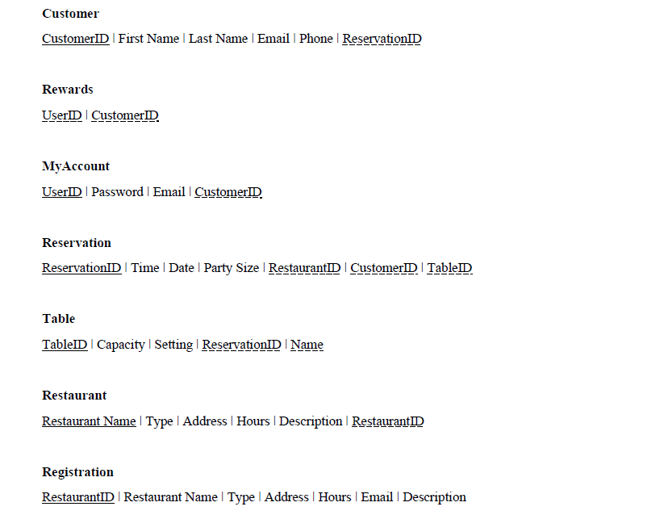
Entity-Relationship Diagram How the data will interact within the database

Slide 7
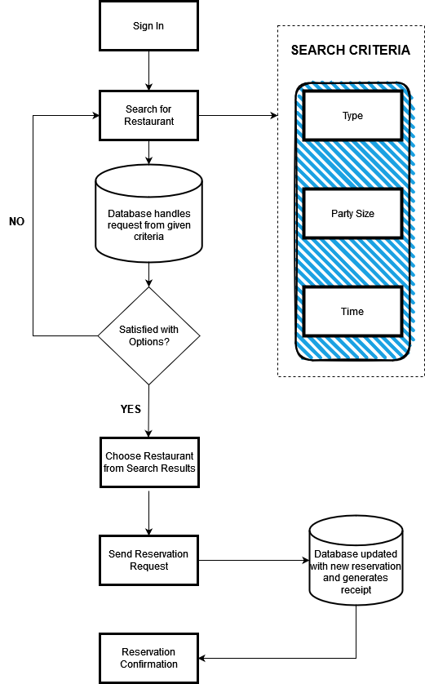
Flow Chart Shows the overall process of table reservation

Slide 8
Demonstration of Implementation

Slide 9
What’s Next?
Mobile Application
Most vital to capturing a large part of the market
Advanced functionality
Detailed reports such as forecasting
Real-time map of seating
Client-side services such as who is currently viewing their restaurant
Bounce rate
View time
Could aid with crowd control to improve flow of operations
Most importantly:
Evolve into a travel site type of experience for itinerary planning
Achieved through future extensions such as Flixster and other entertainment-based applications to suggest activities either before or after a meal
If a user were to travel out of town, TableTop could build an itinerary based on desired trajectory

Slide 10
Thank You!

